Slide 1
Lecture 07
Consensus Algorithms

Slide 2
Do not distribute ...
These slides are not always prepared by me.
Most of the content comes from the reference book
  Bitcoin and Cryptocurrency Technologies: A Comprehensive Introduction
  Arvind Narayanan, Joseph Bonneau,
  Edward Felten, Andrew Miller, Steven Goldfeder
Content on Ethereum 2.0 comes from
https://ethos.dev/beacon-chain/

Slide 3
Proof-of-Stake (PoS)
The right to mine blocks is given out randomly, but proportionally, based on ‘stake’
Stake is defined as some form their share or involvement in the network
  Often the amount of the currency owned
  Example: If you owned 10% of all of the given coin, you could expect to win the right to mine 10% of all blocks

Slide 4
Proof-of-Stake (PoS)
The miners are incentivized to only provide valid blocks, as they have great incentive to keep the network functioning correctly
Their stake or holdings will be worthless if the network fails to function

Slide 5
Proof-of-Stake (PoS)
There are many variations on Proof of Stake (often named something slightly different), and the mechanisms by which rewards are distributed, validators are selected, and stake is determined
  Some implementations demand that miners put their coins into escrow that is lost if they break the rules
Notes:
Stake Escrow: Many implementations do not actually require an escrow of coins. In the implementations that do require escrow, there are often complicated rules on how and when the escrow is actually forfeit. There is often a ‘gray area’ of node actions that are not correct, but are not directly attack the network, that do not result in escrow forfeiture.
Guess and Check Combinations: In certain (many?) implementations of proof-of-stake, the validators / forgers / miners (various names for block creating nodes) have options of what to include in the block. For example, they may choose to include lower fee transactions in the block, if this results in the block hitting the target difficulty with their current stake input.

Slide 6
PoS Strengths
No useless mining: there is no unnecessary use of resources to further power the blockchain
Little to no hardware advantage
  ASIC mining pools do not have a significant advantage over a powerful home computer
Those ‘guarding’ the value of the coins have the most to lose if the network is compromised
  The incentives to be honest are aligned with individuals motives

Slide 7
PoS Strengths
The 51% attacks becomes essentially infeasible
  An attacked would need to accumulate 51% of all the coins on the network to accomplish this
  Currently for Ethereum this is more than $6 Billion, which would be lost if the attack were successful
Proof of Stake has the potentially to be magnitudes more efficient than PoW, making it significantly more scalable
  Very high transaction throughput is possible with PoS (transactions per second)

Slide 8
PoS Drawbacks
Theoretically encourages centralization:
  Higher stake means higher rewards, keeping the ‘rich’ richer
Not as much "battle" tested as PoW

Slide 9
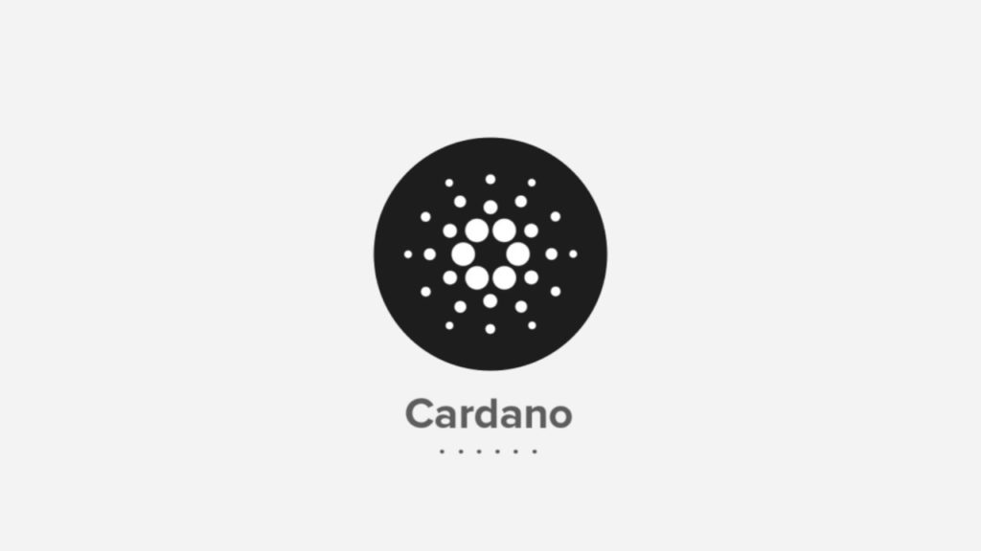


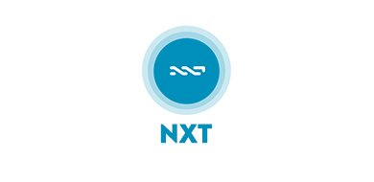

Current PoS Systems
Ethereum (not yet)
Cardano
Waves
Peercoin
Nxt

Slide 10

Delegated-Proof-of-Stake
Developed by Dan Larimer in 2013
This consensus model is aimed at modeling a digital democracy
Token holders (stakeholders) can vote for witnesses
  The number of votes they can cast is proportional to their token holdings

Slide 11
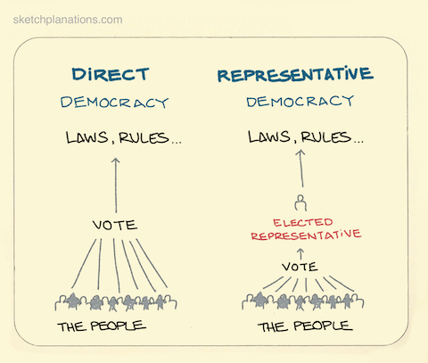
Delegated-Proof-of-Stake
https://www.sketchplanations.com/post/148150419096/direct-and-representative-democracy-in-direct

Slide 12
Delegated-Proof-of-Stake
Witnesses are the block creators, and are paid transaction fees when they create a new block
Witnesses can be voted out at any time, and thus will lose their income if they do not create new blocks, or create blocks that are not trustworthy

Slide 13
Delegated-Proof-of-Stake
In some cases, witnesses are rotated on a regular basis to give more people opportunity to participate
Current projects include Bitshares, Steem, EOS, Lisk and Ark

Slide 14
Ethereum 2.0
https://ethos.dev/beacon-chain/

Slide 15
Crosslinks
They link Shards to the Beacon Chain
As there are 64 shards, each beacon block can contain up to 64 crosslinks.
A beacon block might only have one crosslink, if at that slot, there were no proposed blocks for 63 of the shards.

Slide 16
Slots and Epochs
Every 12 seconds, one beacon (chain) block and 64 shard blocks are added when the system is running optimally.

Slide 17
Ethereum 2.0
Validators are actively participating in the consensus of the Ethereum 2.0 protocol.
Ethereum 2.0 validators are Proof of Stake “virtual miners”.
A block proposer is a validator that has been pseudorandomly selected to build a block. The not selected ones are attesters
An attestation is a validator’s vote, weighted by the validator’s balance.

Slide 18
Ethereum 2.0
https://ethos.dev/beacon-chain/

Slide 19
How to become a validator?
In Ethereum 2.0, users stake ETH to activate and control validators.
Stakers can stake all their ETH by activitating Validators.
Each validator has a maximum balance of 32 ETH and For every 32 ETH staked, one validator is activated.

Slide 20
RANDAO
At every epoch, a pseudorandom process RANDAO selects proposers for each slot, and shuffles validators to committees.
A committee is a group of validators. For security, each slot has committees of at least 128 validators.

Slide 21
Summary
Ethereum consensus algorithm is an example of PoS?

Slide 22

Proof-of-Importance
Introduced by NEM, and aims to solve problems with PoW and PoS
  Discourages coin hoarding, and ASIC hardware gives you no advantage
Notes:
Delegated Harvesting: I have been unable to fully determine how the reward system works. By delegating your importance, you collect some rewards. Some sources seem to indicate that you get all of the reward, some seem to indicate that the node doing harvesting get the transaction fees. https://docs.nem.io/ja/nanowallet/delegated-harvesting/benefits-of-delegated
NEM (New Economy Movement) is a blockchain platform and cryptocurrency that was created to enable a new digital economy. It was initially launched in 2015 and has undergone several updates and iterations since then. NEM is designed to offer unique features and a distinct consensus algorithm called "Proof of Importance" (PoI).

Slide 23
Proof-of-Importance
Nodes are assigned an ‘Importance Score’ based on 3 factors, and selected to harvest (mine) blocks proportional to this score (similar to PoS selection)
  Stake: Coins vest power over time, and more coins leads to higher importance (similar to PoS)
  Partners: The algorithm considers who and how many people you have made transactions with, encouraging using the network as a payment
  Recent Transactions: Large, recent, and frequent transactions have a large impact on Importance Score
Notes:
Delegated Harvesting: I have been unable to fully determine how the reward system works. By delegating your importance, you collect some rewards. Some sources seem to indicate that you get all of the reward, some seem to indicate that the node doing harvesting get the transaction fees. https://docs.nem.io/ja/nanowallet/delegated-harvesting/benefits-of-delegated

Slide 24
Proof-of-Importance
What is the main motivation here?
The structure encourages and rewards people for using the blockchain functionally (as currency), as opposed to using it just as a way to generate income
Notes:
Delegated Harvesting: I have been unable to fully determine how the reward system works. By delegating your importance, you collect some rewards. Some sources seem to indicate that you get all of the reward, some seem to indicate that the node doing harvesting get the transaction fees. https://docs.nem.io/ja/nanowallet/delegated-harvesting/benefits-of-delegated

Slide 25


Proof-of-Authority
Authentication nodes (mining nodes) require reliable and thorough identity confirmation
  This kind of blockchain is known as a permissioned blockchain
Notes:
B2: The identity of a party being added to the chain is confirmed off-chain. The examples often require a public official (notary) to do some verification of the person, and then on-chain authorities add them. The on chain authorities can be the blockchain owner, or a trusted committee of people / nodes.
B4: Forfeiting their identity is in essence losing their identity stake (identity -> collateral). The chain is proposed as this both having on chain consequences (losing ability to participate) and off chain (would go on a public record of some sort, similar to a criminal record).
VeChain is a blockchain platform designed for enterprise use cases, with a focus on supply chain management and tracking. It aims to enhance transparency, traceability, and authenticity of products and data throughout their lifecycle.

Slide 26
Proof-of-Authority
The identity of the node is at stake, in addition to the holdings (currency) which they are staking
  Identity can serve as a more powerful motivator for honest behavior than financial consequences
Notes:
B2: The identity of a party being added to the chain is confirmed off-chain. The examples often require a public official (notary) to do some verification of the person, and then on-chain authorities add them. The on chain authorities can be the blockchain owner, or a trusted committee of people / nodes.
B4: Forfeiting their identity is in essence losing their identity stake (identity -> collateral). The chain is proposed as this both having on chain consequences (losing ability to participate) and off chain (would go on a public record of some sort, similar to a criminal record).

Slide 27
Proof-of-Authority
In the case of a malicious actor, not only is their stake forfeit (and in some cases all of their holdings), but also their identity: their reputation is tarnished
Addresses the Sybil attacker issue (without getting into faking government identification)
Notes:
B2: The identity of a party being added to the chain is confirmed off-chain. The examples often require a public official (notary) to do some verification of the person, and then on-chain authorities add them. The on chain authorities can be the blockchain owner, or a trusted committee of people / nodes.
B4: Forfeiting their identity is in essence losing their identity stake (identity -> collateral). The chain is proposed as this both having on chain consequences (losing ability to participate) and off chain (would go on a public record of some sort, similar to a criminal record).

Slide 28

Proof-of-Elapsed-Time
It requires a permissioned blockchain:
  Participants identify themselves to the network, and the network can decide to let them participate
Notes:
Sawtooth is an open-source blockchain platform developed by Intel and the Hyperledger project, which is hosted by the Linux Foundation. It is designed to be a flexible and modular framework for building and deploying distributed ledger applications (DLTs) and blockchain networks.

Slide 29
Proof-of-Elapsed-Time
At a high level, this consensus algorithm is essentially a random lottery between all participating nodes deciding who gets to mine the next block
  Participating nodes use a trusted timer to wait a randomly assigned time
  The first node to finish waiting it’s given time is able to mine the next block
  The block is verified by the other participants, and new times are assigned (drawn)

Slide 30
Proof-of-Elapsed-Time
Relies on trusted code: Intel Software Guard Extensions (SGX) - keeps the lottery fair
Not suitable algorithm for public, untrusted blockchains, but demonstrates another flavor of consensus algorithms possible when conditions are applied to the consensus problem
Notes:
PoET relies on trusted execution environments (TEEs) to create a fair lottery system for selecting the next block validator. TEEs are secure hardware components that can provide tamper-resistant execution environments. In a PoET network, participants request a "wait time" from a TEE.

Slide 31
Intel SGX
A specialized hardware component can create an attestation that some particular trusted code was set up correctly in a protected environment. e.g. An external party can use the attestation to verify that the right code is running the right way.
Trusted code runs in an environment that is private to the rest of the application. e.g. The rest of the application can’t inspect or interfere with the memory space of the trusted code.

Slide 32
PoET’s trusted code – Join
A new participant downloads the trusted code for the blockchain.
Participant sends a SGX attestation to the rest of the network as part of a join request.

Slide 33
PoET’s trusted code – Participate
Participant obtains a signed timer object from the trusted code.
Participant waits for the time specified by the timer object.
Participant obtains a certificate (signed by the trusted code’s private key) that the timer has completed. Participant sends this certificate to the rest of the network along with the new block for the blockchain.

Slide 34
PoET’s trusted code – Participate
The protocol also involves other protections on top of SGX. For example, the network measures how often a given participant wins the lottery in order to detect participants with a compromised SGX system. Bad actors can then be blacklisted.
Notes:
https://medium.com/kokster/understanding-hyperledger-sawtooth-proof-of-elapsed-time-e0c303577ec1

Slide 35
Practical Byzantine Fault Tolerance (pBFT)
One node is designated as leader
When a user of the network (client) sends a transaction, the leader casts (redirects) the request to all of the other active nodes in the sequence (called backup nodes)
The client awaits a certain number (#nodes x 2/3 + 1) of the same response sent from the backup nodes, at which point the transaction is final
Notes:
Resistant to ⅓ faulty or untrustworthy nodes: From my research, it appears as if this is a chosen number. It has to do with balancing speed of the network with security. When the leader is verifying a transaction, he waits for (#nodes*2/3) + 1 identical responses. Once he receives those responses, he considers the transaction valid and moves on. If the number were higher (say ⅔), the transactions would take longer to process, as the leader would have to wait for more responses.

Slide 36
Practical Byzantine Fault Tolerance (pBFT)
The leader can be replaced each round with the nodes voting on the next leader, or can even be replaced in the middle of a round if the leader fails to cast the clients requests or is deemed as faulty by a super majority of the participating nodes
Resistant to ⅓ faulty or untrustworthy nodes:
  With at most ⅓ of the nodes being faulty, the system will be both live and trustworthy
Notes:
Resistant to ⅓ faulty or untrustworthy nodes: From my research, it appears as if this is a chosen number. It has to do with balancing speed of the network with security. When the leader is verifying a transaction, he waits for (#nodes*⅓) + 1 identical responses. Once he receives those responses, he considers the transaction valid and moves on. If the number were higher (say ⅔), the transactions would take longer to process, as the leader would have to wait for more responses.

Slide 37
Practical Byzantine Fault Tolerance (pBFT)
Advantages:
  There is no need for block confirmations, all transactions are final once the client receives the responses
  Significantly more energy efficient that PoW
Disadvantages:
  Only works efficiently with a small number of participating backup nodes
  Also runs into issues with single parties faking multiple nodes (Sybil attack)
Notes:
Resistant to ⅓ faulty or untrustworthy nodes: From my research, it appears as if this is a chosen number. It has to do with balancing speed of the network with security. When the leader is verifying a transaction, he waits for (#nodes*⅓) + 1 identical responses. Once he receives those responses, he considers the transaction valid and moves on. If the number were higher (say ⅔), the transactions would take longer to process, as the leader would have to wait for more responses.

Slide 38

Practical Byzantine Fault Tolerance (pBFT)
Zilliqa pBFT in combination with PoW every 100 blocks

Slide 39

Practical Byzantine Fault Tolerance (pBFT)
Hyperledger Fabric
  Open source collaborative project hosted by Linux Foundation
  Permissioned version of pBFT

Slide 40

Proof-of-Capacity
Nodes ‘map’ or ‘plot’ their storage (hard-drive) with a very slow hashing algorithm (Shabal)
  This is essentially pre-storing the solutions to blocks in their hard drive
Each block, the person with the lowest hash (quickest) solution wins the right to mine the block

Slide 41
Proof-of-Capacity
The larger the storage allocated for the map, the more likely that node wins the block
  As the hashing is very slow, it’s infeasible to attempt to compute new solutions in real time
As the solutions are stored, minimal computation is needed for each new block

Slide 42
Proof-of-Capacity
Advantages: very power efficient, equipment lasts a long time, equipment readily available
Disadvantages: potential for specialized storage arms race (PoW arms race for hashing power)
  Hard drive space used for mining is useless
Has seen very little adoption: Only Burstcoin implements the algorithm (Algorithm released 2014)
  Network peaked at ~0.4 Exabytes (400,000 Terabytes)

Slide 43
Do not distribute ...
These slides are not always prepared by me.
Most of the content comes from the reference book
  Bitcoin and Cryptocurrency Technologies: A Comprehensive Introduction
  Arvind Narayanan, Joseph Bonneau,
  Edward Felten, Andrew Miller, Steven Goldfeder

